Slide 1
Managing System for Animal Shelter
By Popeyes

Slide 2
Problem statement
Each year in the US, 8 to 10 million lost and unwanted dogs and cats enter animal shelters. They have only about a fifty percent chance of getting out alive: 4 to 6 million of them will be euthanized - around a half million a month nationwide, 575 each hour, one every six and a half seconds. Our project is trying to connect homeless animals and adopters more easier and efficiently.

Slide 3
Approach
1. Complete and standardise the process of adoption
2. Shelters in different locations can communicate and send request for transferring animals
3. Automatically transfer animals between shelters for convenience of adopters
4. Customers and volunteer sharing the information in a whole system
5. Rating system of inspection after adoption
6. Finding lost pets
7. A platform for foster and exchanging information
8. Analysis of animal’s variety in different locations

Slide 4
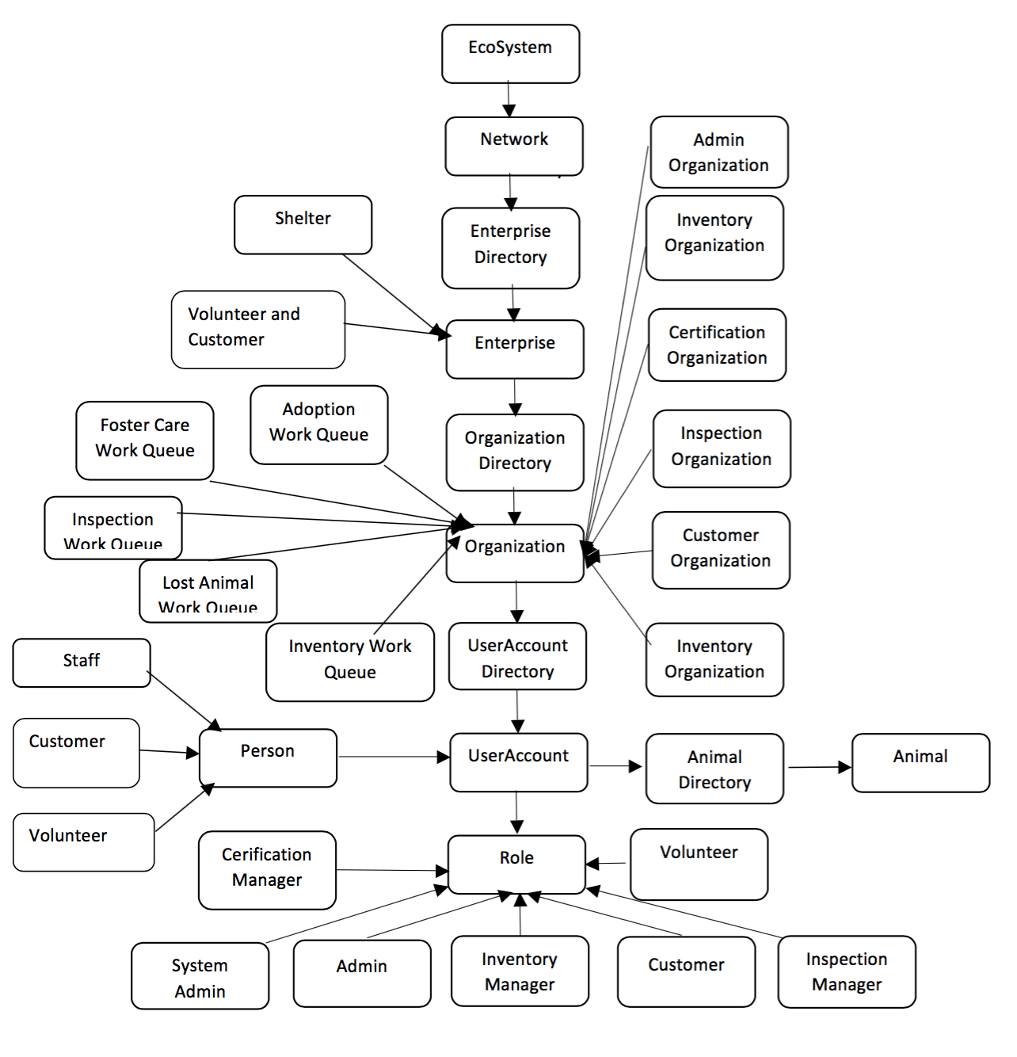
Object model

Slide 5
Use cases
1. As an inventory manager, it is your responsibility to manage the inventory of shelter, and view adoption and lost animals history.
2. As a certification manager, you can make judgment and decisions on customers’ application for adoption or lost animals.
3. As a inspection manager, you can cooperate with volunteers to inspect the adopted animal.
4. As a customer, you can either apply for an adoption, or find your lost pet. And you can look for help or help others as a foster.
5. As a volunteer, you can help shelters implement inspection and rate how adopters behave.

Slide 6
ScreenSHOTS
KEY SCREENS OF THE SYSTEM

Slide 7

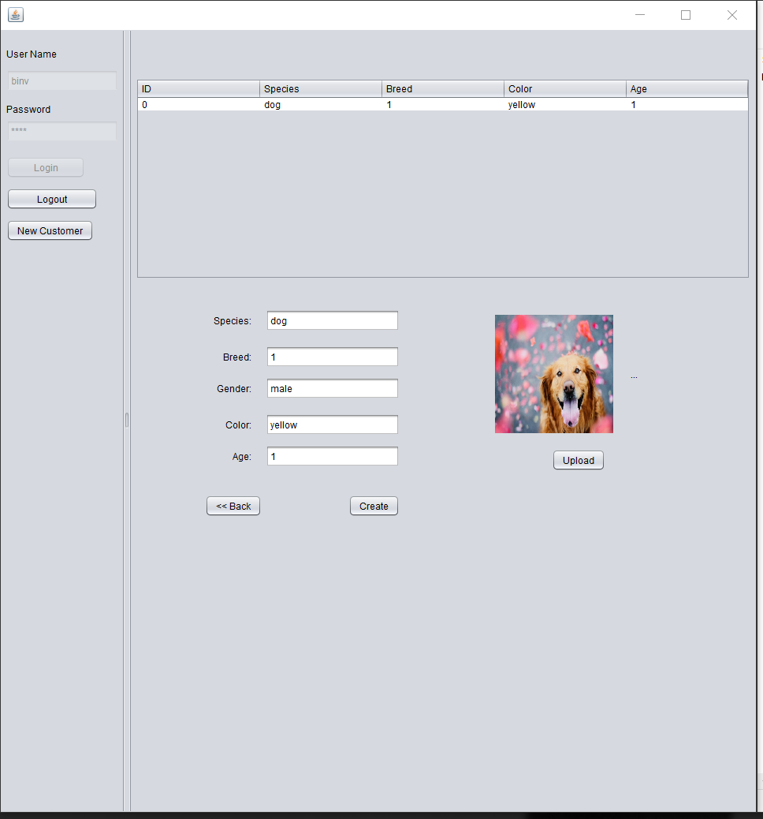
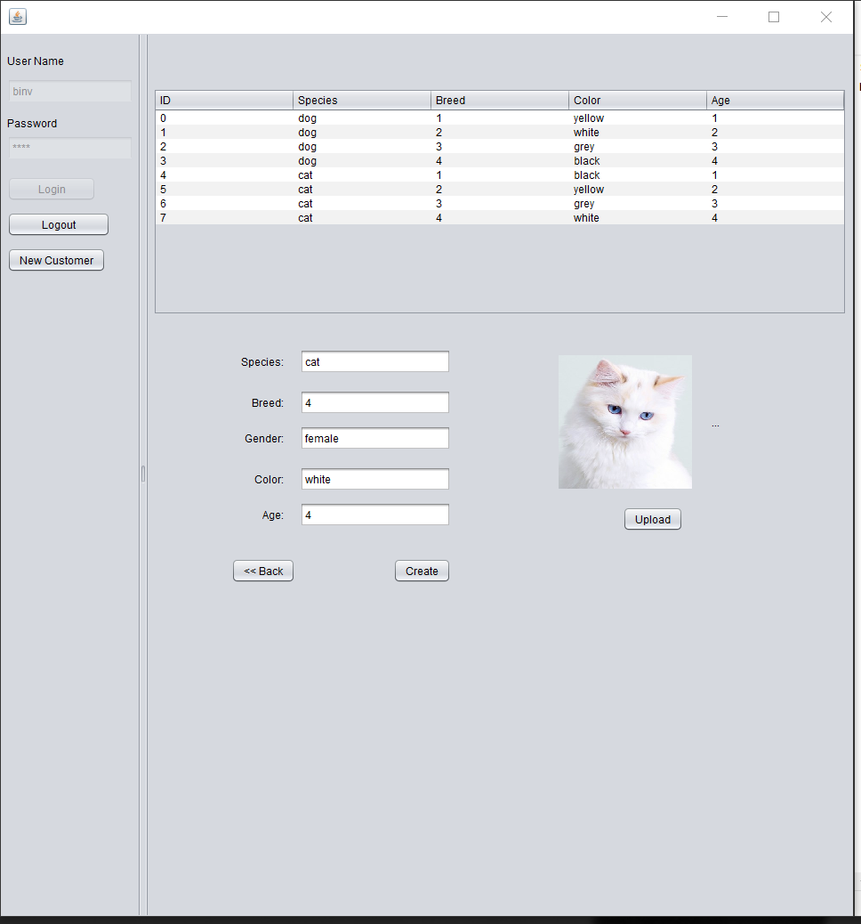

Slide 8

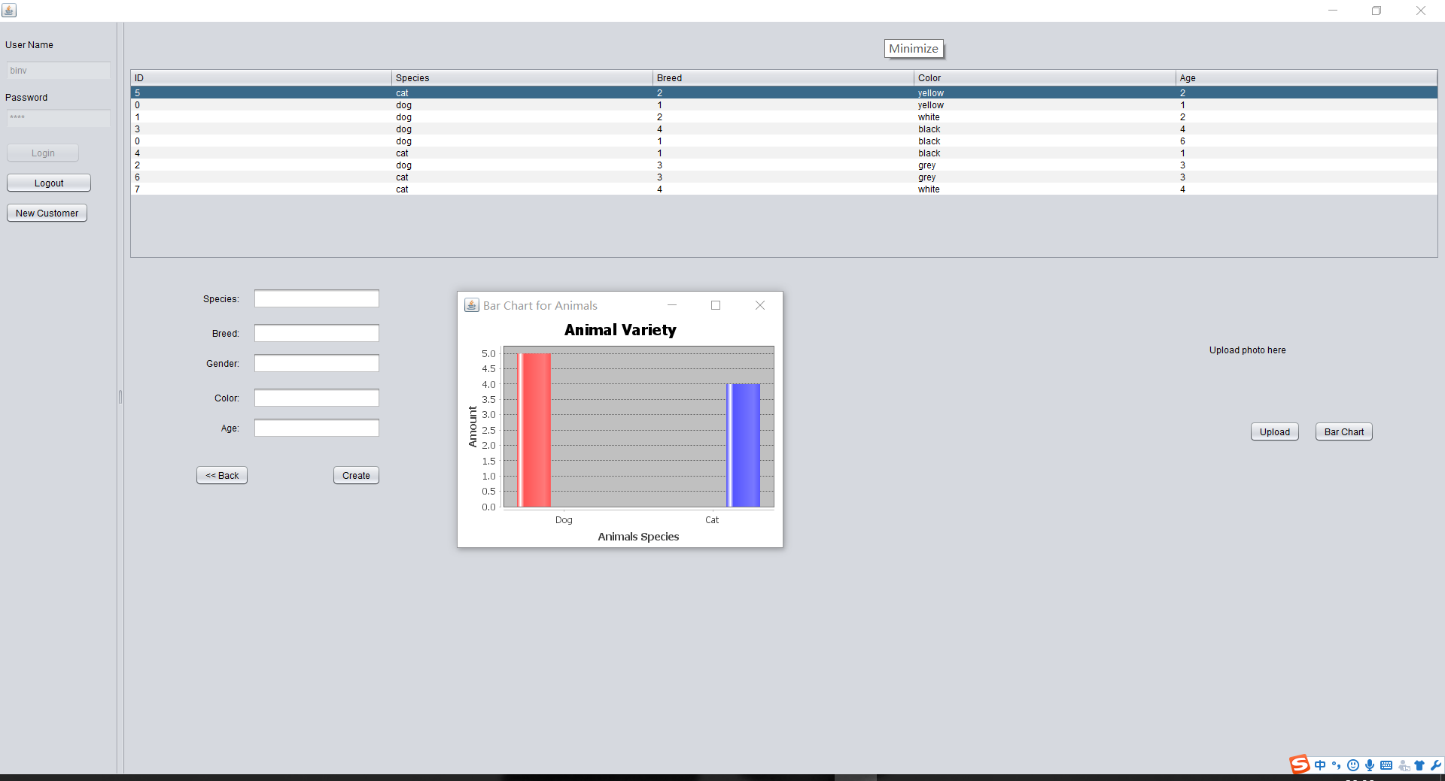

Slide 9
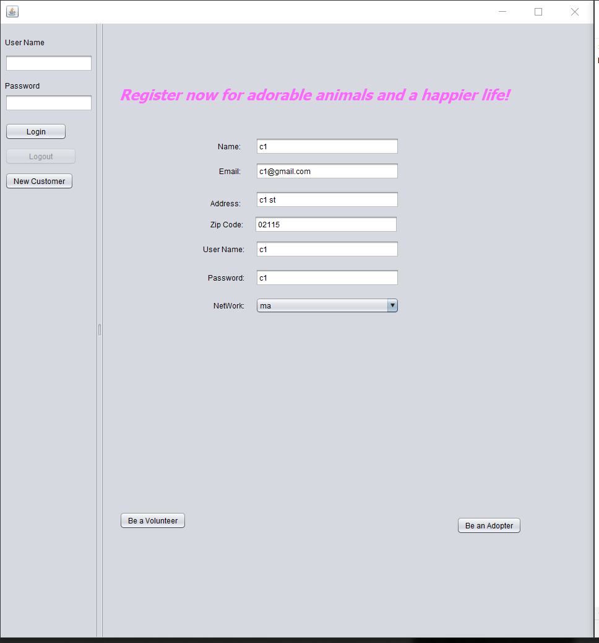

Slide 10
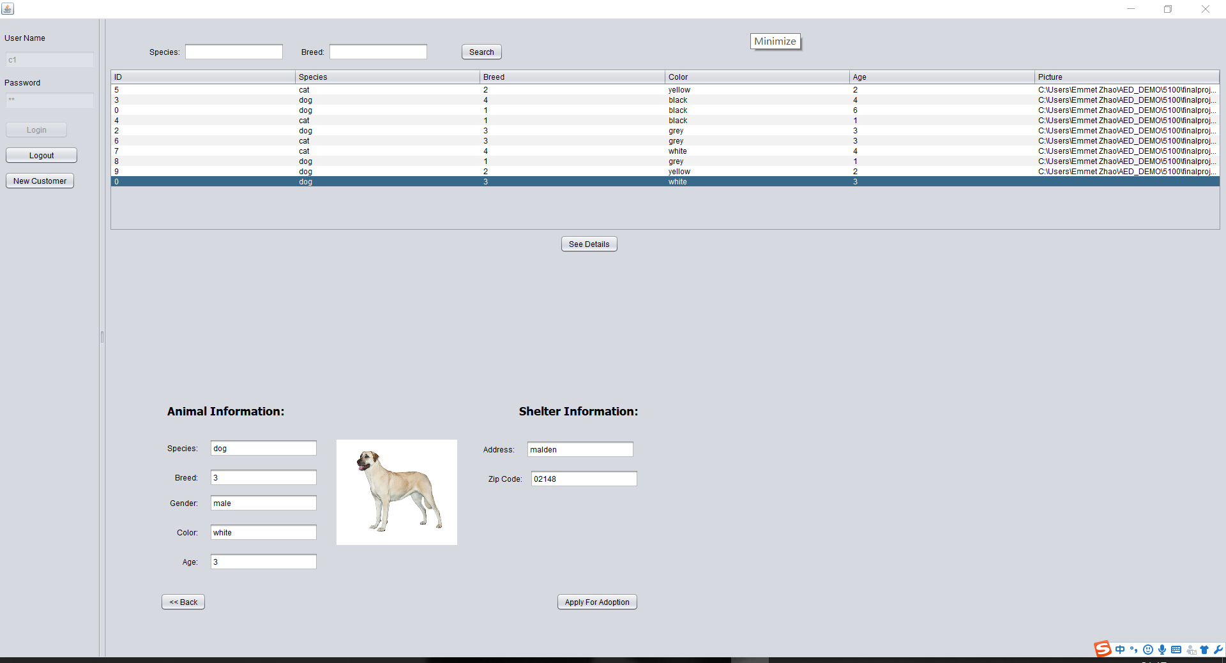

Slide 11
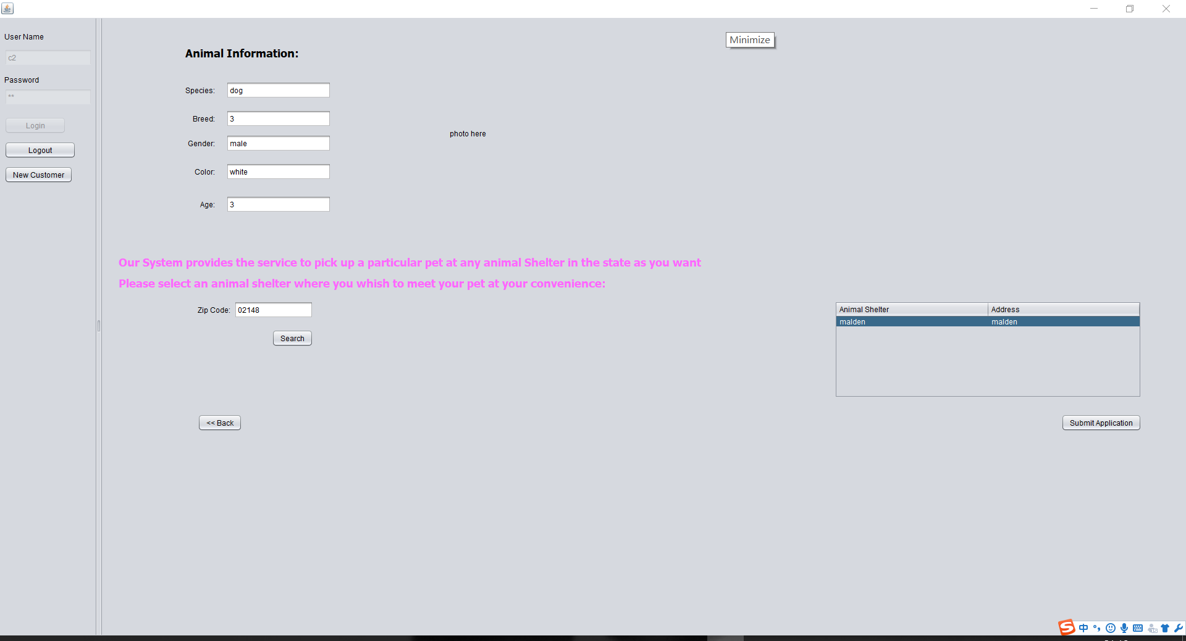

Slide 12

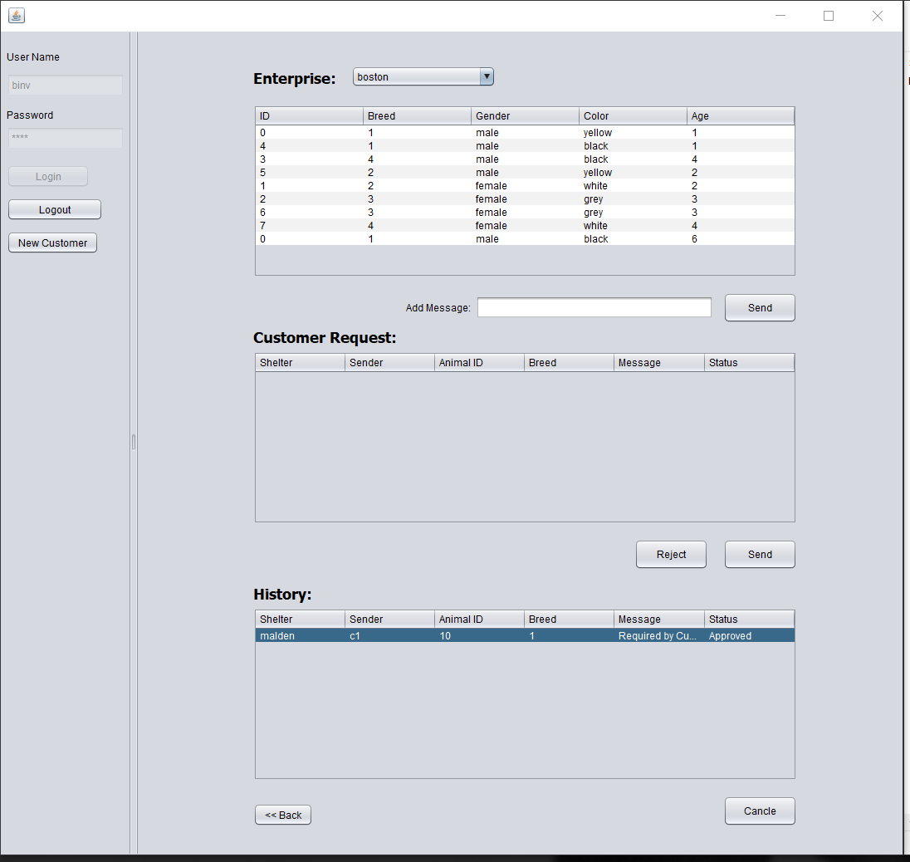
Inventory

Slide 13
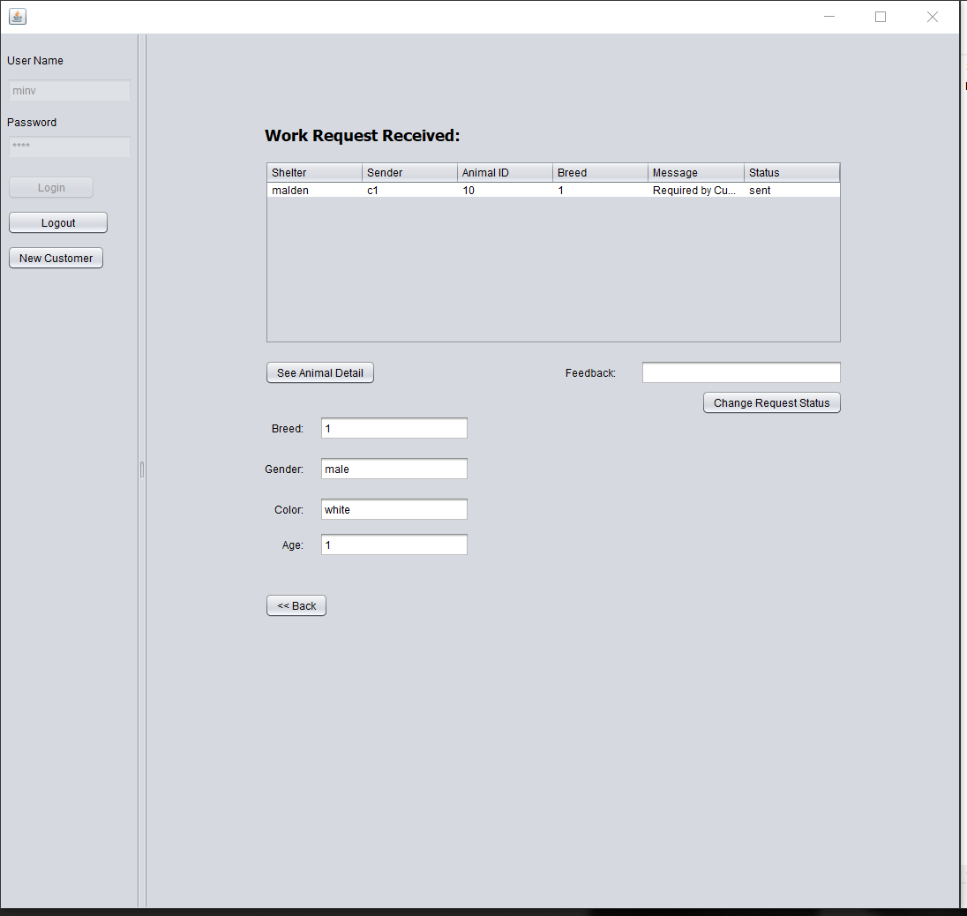

Slide 14
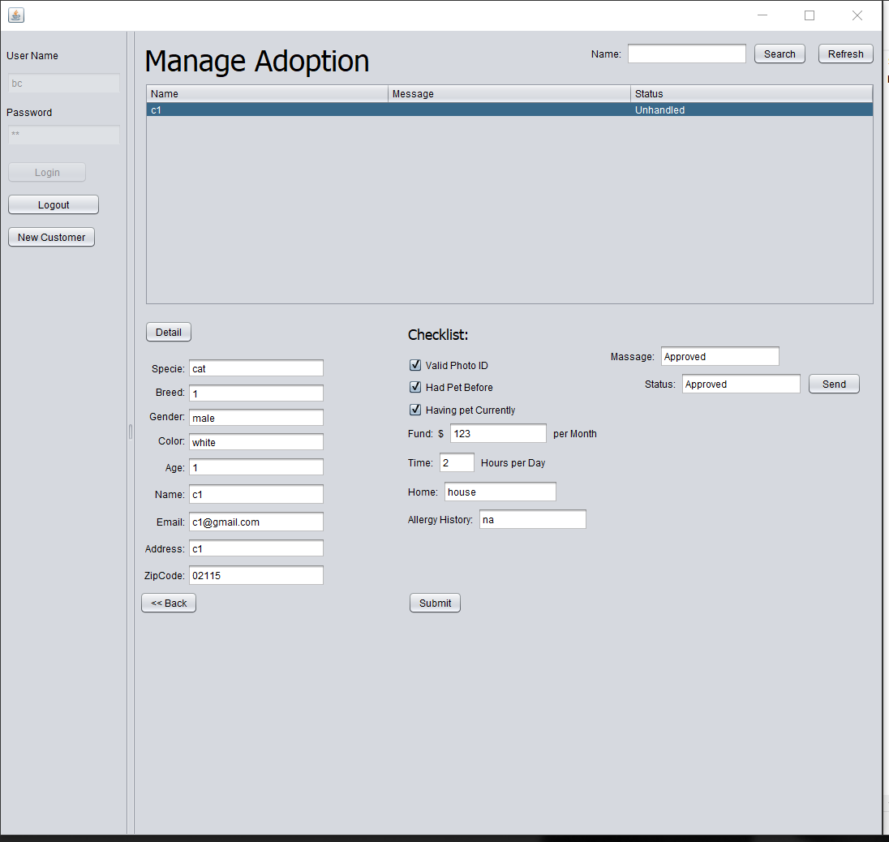
Certification

Slide 15
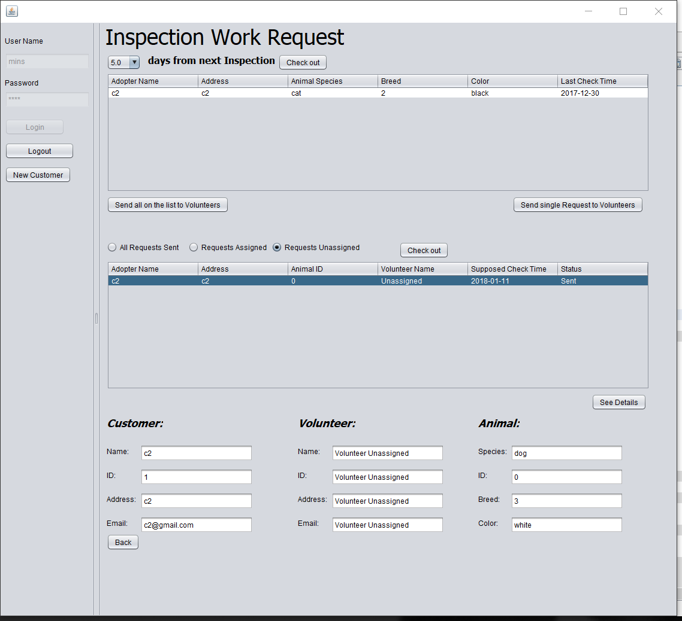
INSPECTION

Slide 16
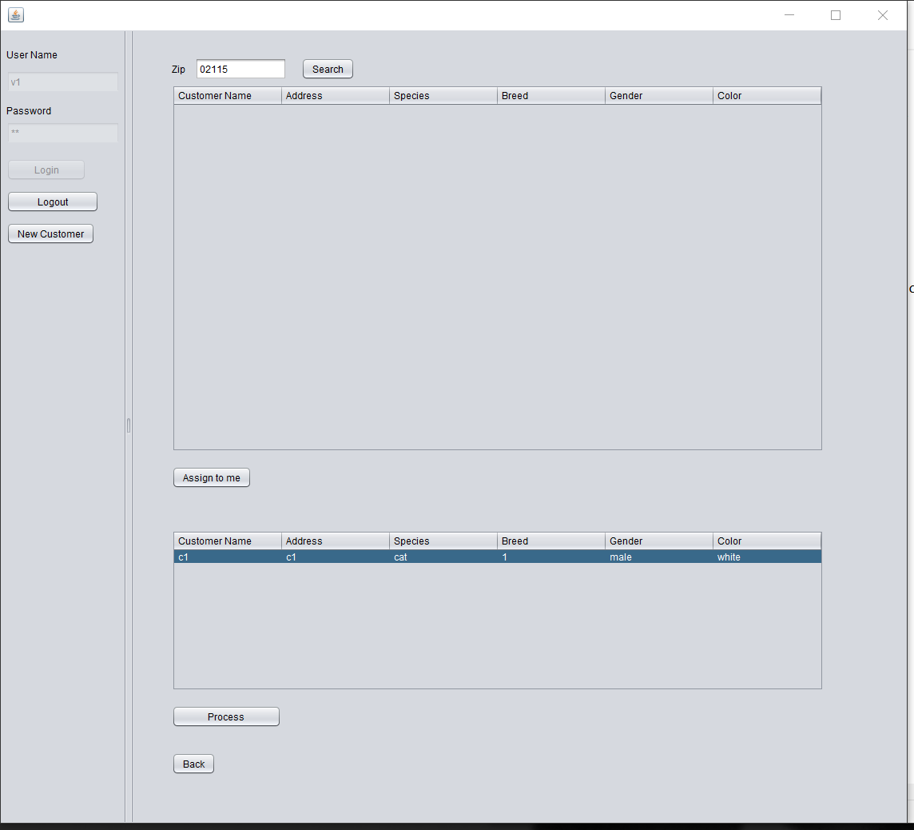
VOLUNTEER

Slide 17
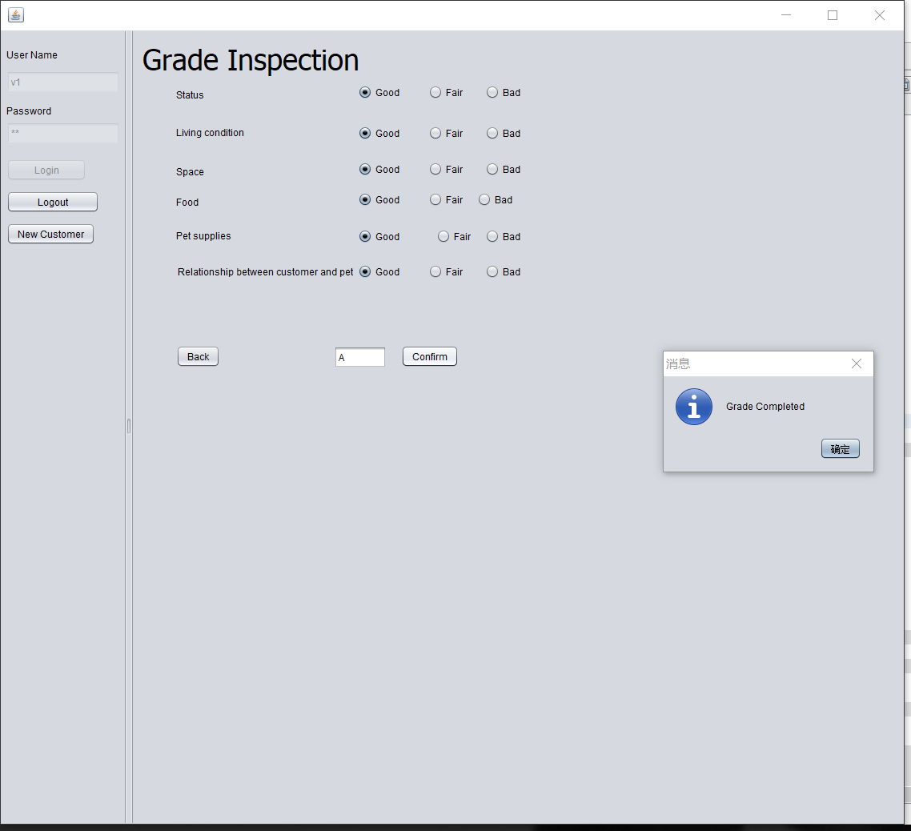
Rating
system of inspection

Slide 18
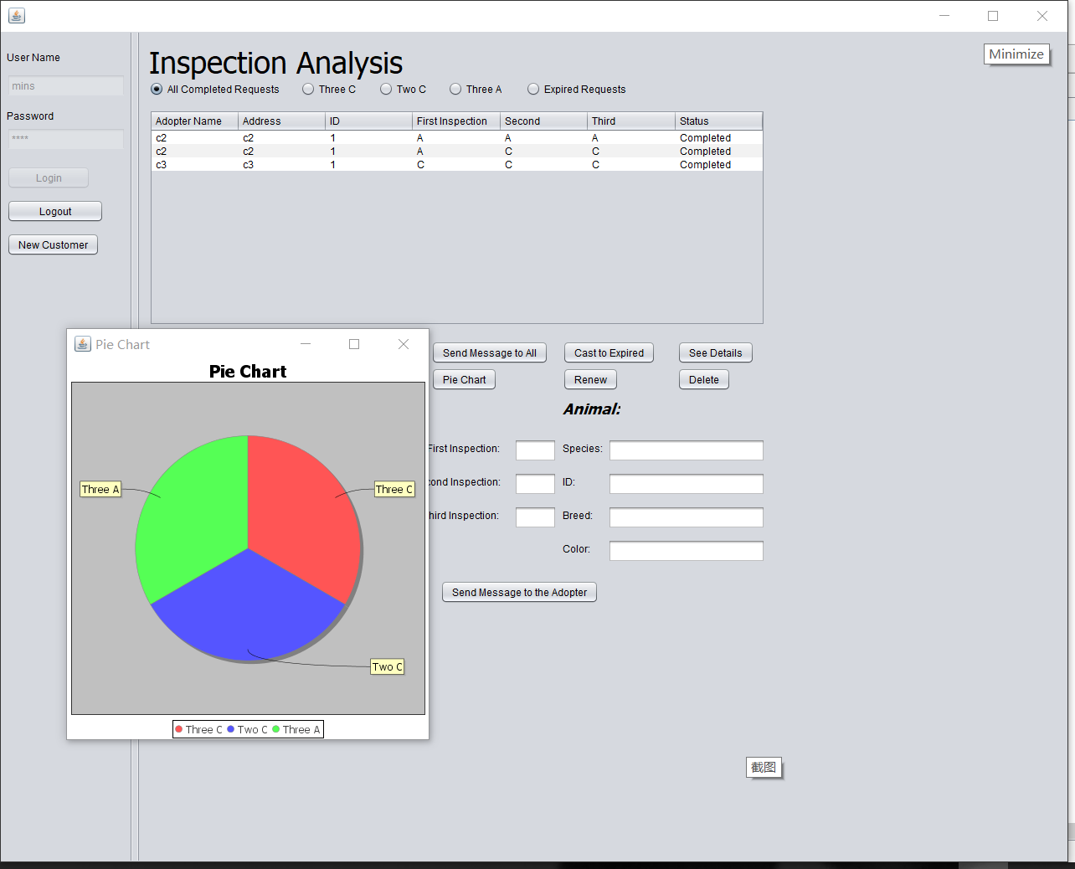
Analysis
And
statistics

Slide 19
Find Your Lost Animal
In our shelters

Slide 20
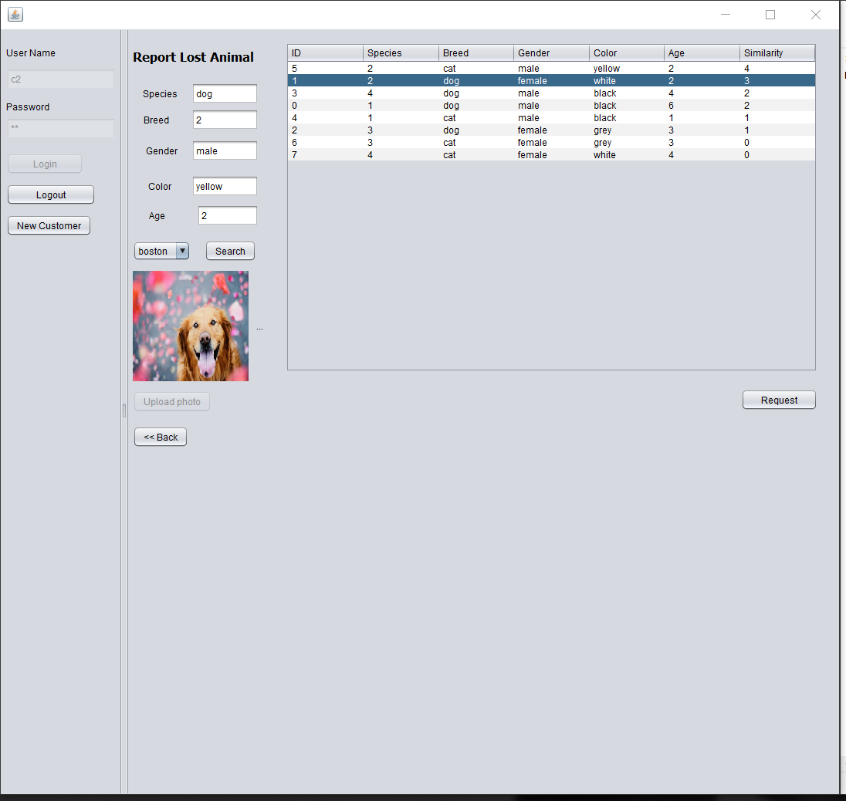

Slide 21
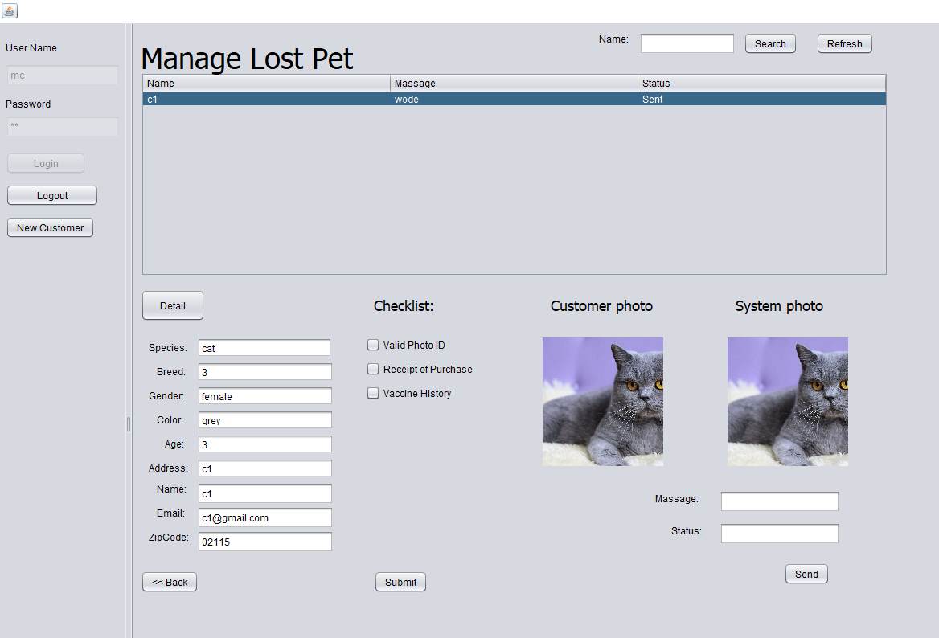
Certification

Slide 22
request &provide
foster care

Slide 23
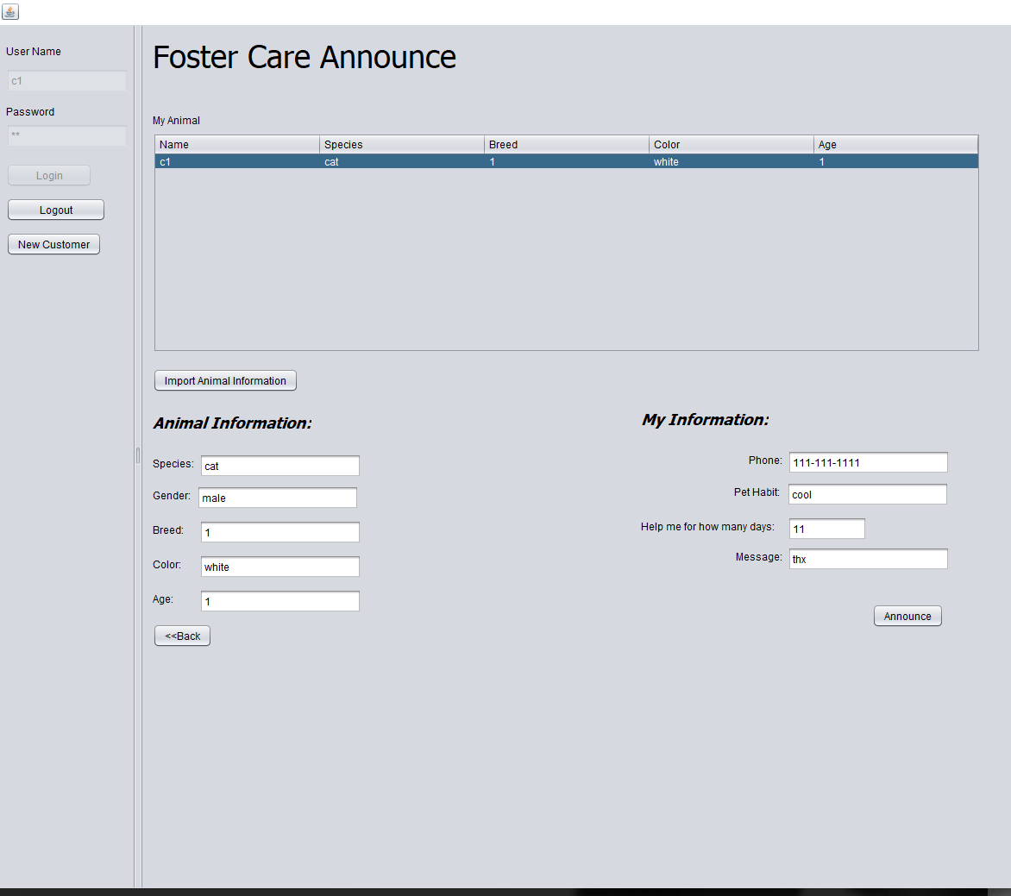
Someone
need help
with their pets

Slide 24
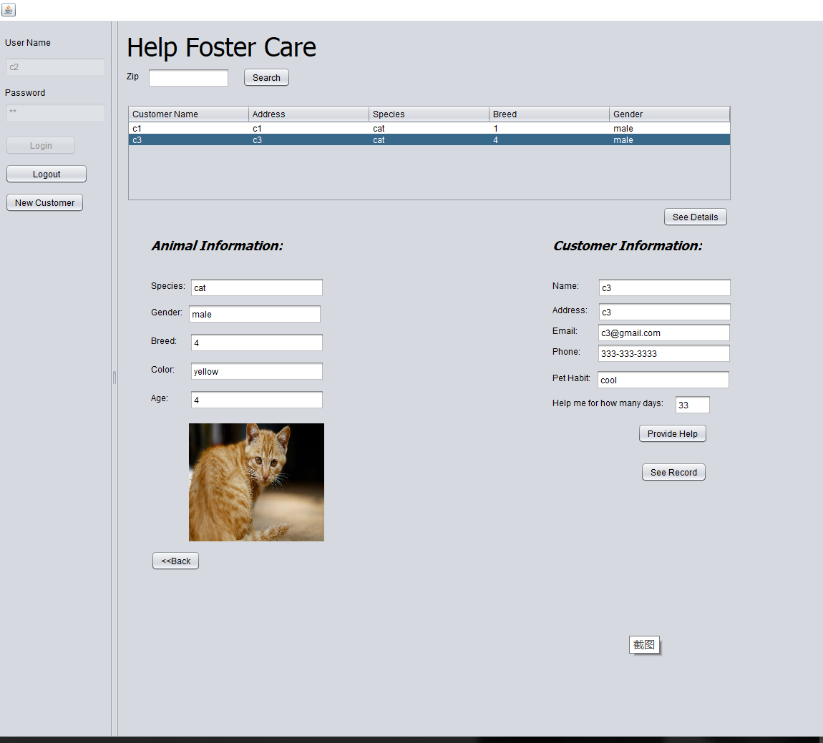
I’d like to
Help

Slide 25
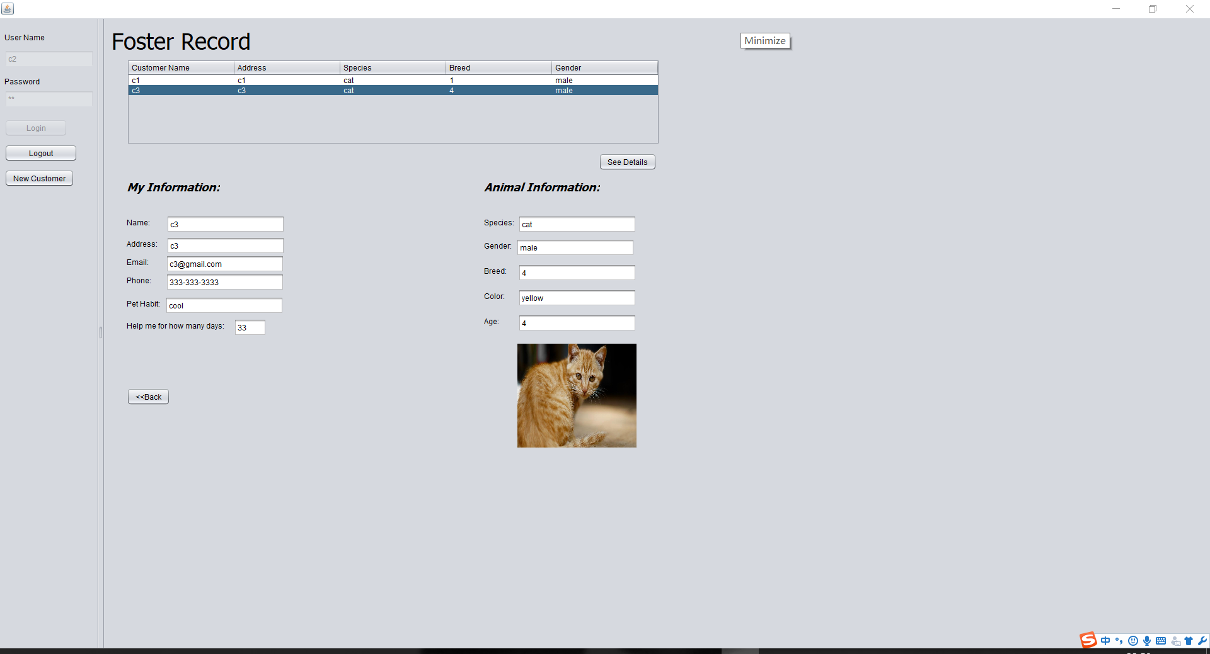

Slide 26
Thanks!

